Slide 1
Python for Chemists and Biochemists
Take a sticky note of each color (pink, green, blue)
Find a seat where you can see the screen and get your laptop out

Slide 2
Introduce yourself to your neighbors

Slide 3
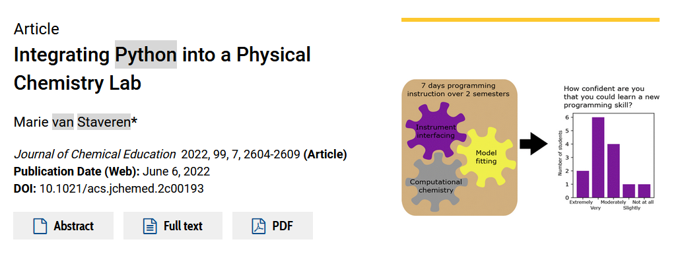

How’d we get here
Grad work: modeling four wave mixing experiments using Python
Connected to the astronomy Python community, Software Carpentry
Attended MolSSI Train the Trainers workshop at BCCE this summer
Thought maybe the grads should catch up to our undergrads…

Slide 4


Slide 5
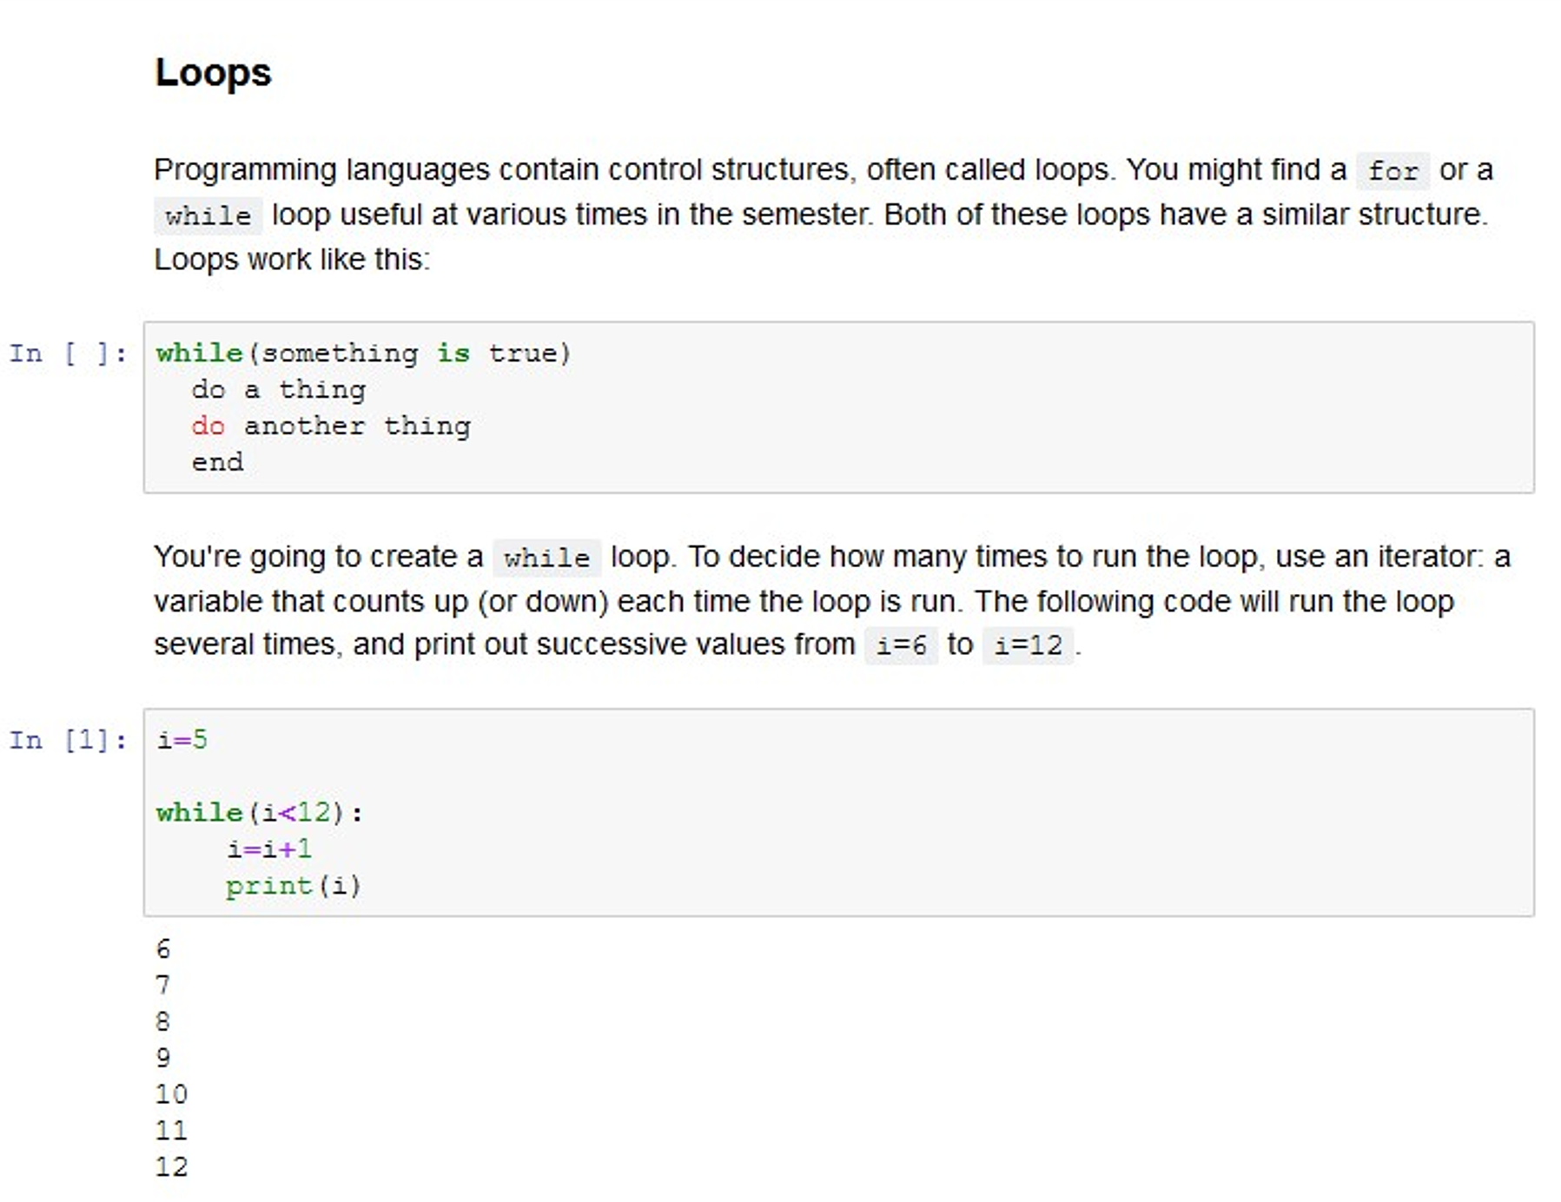
The language
Python
Open source
The standard in many areas of science and engineering
Robust stack of libraries to solve almost any scientific problem
Good Monty Python Jokes
Jupyter
Like a lab notebook
Less intimidating for scientists
The method for analyzing data from JWST

Slide 6
Sticky notes: Put them on your laptop
This one means you’re good
This one means you need help

